Slide 1
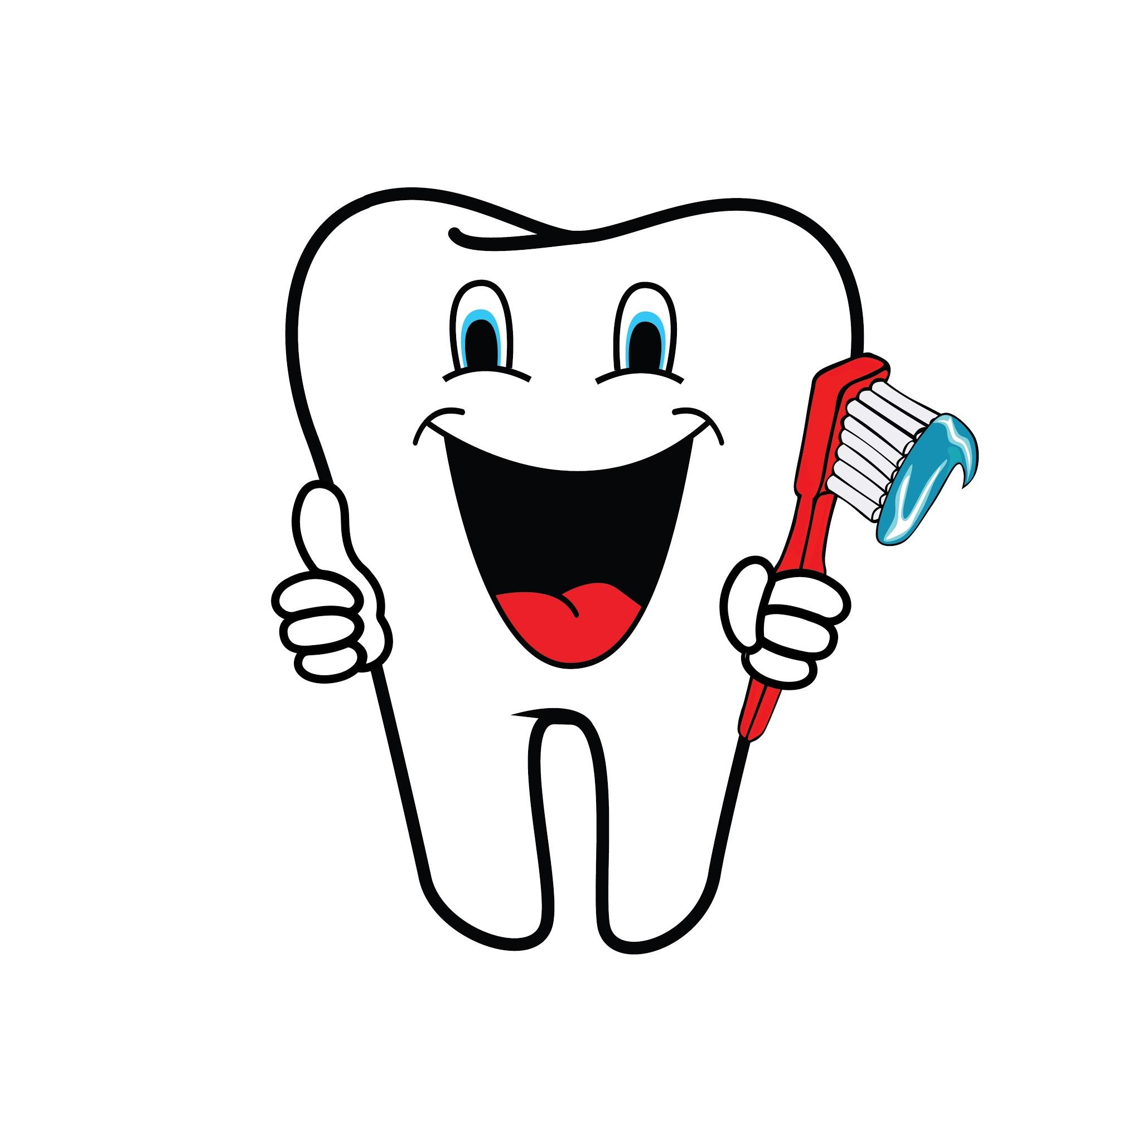
Marketing Analytics
Project: Dental Insurance

Slide 2
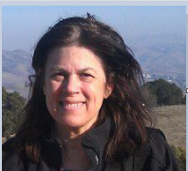
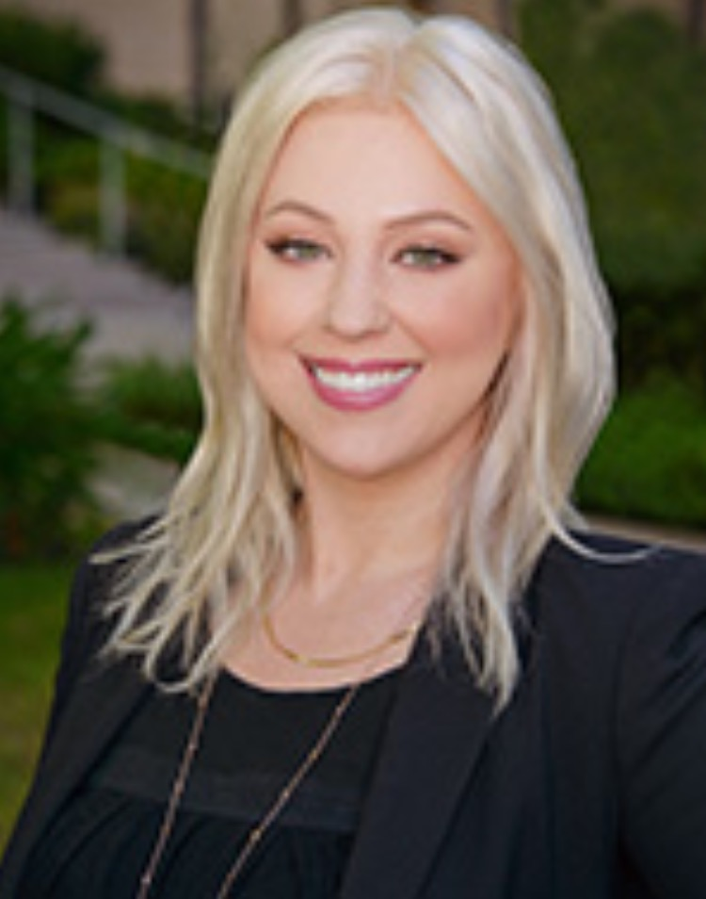
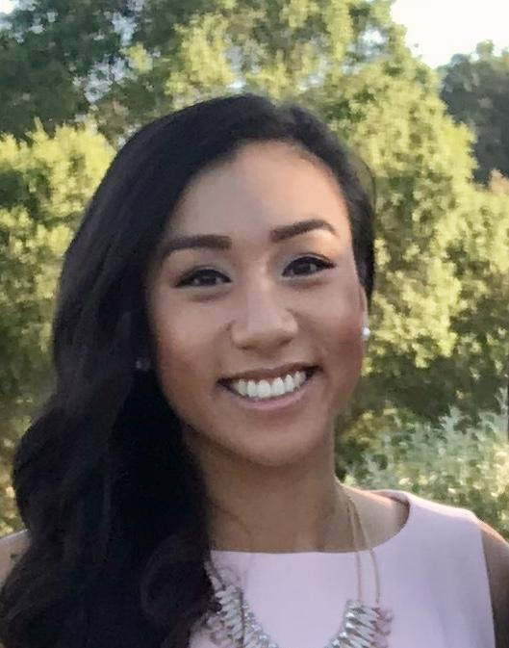
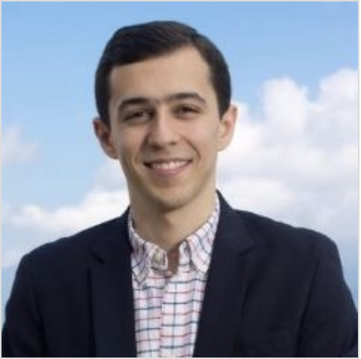
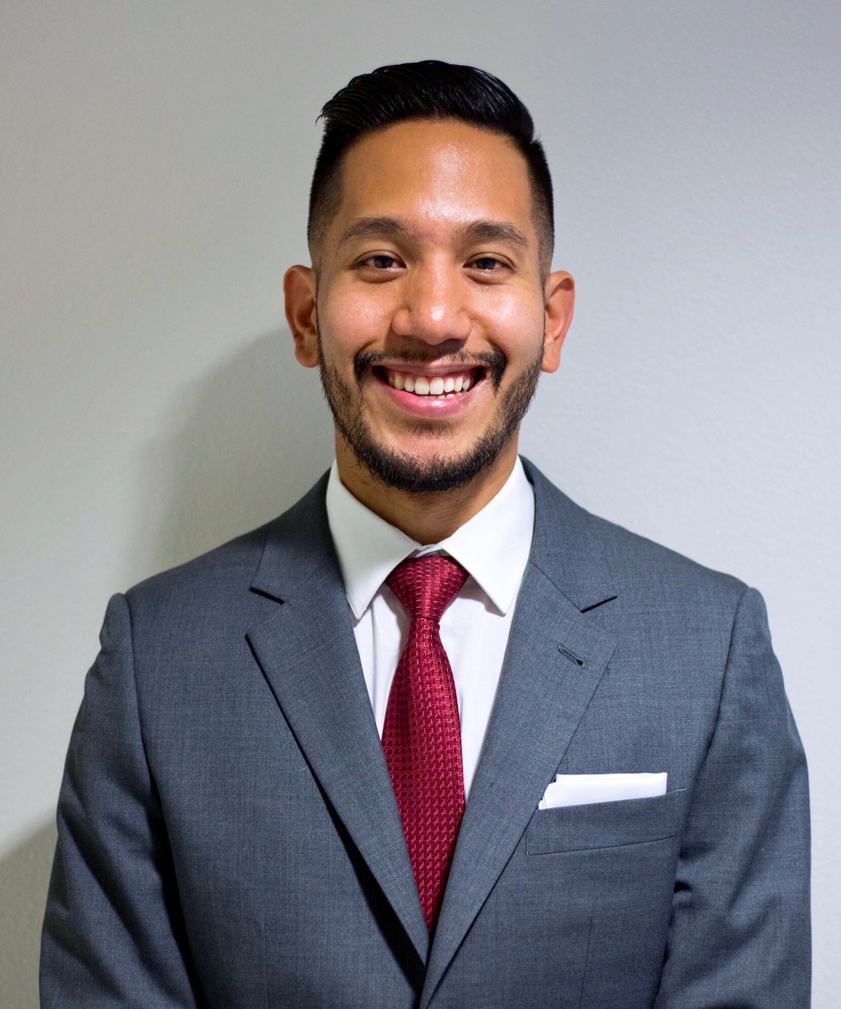

MEET THE TEAM
Sandy
Nicole
May
Simon
Jon
Yibo

Slide 3
An apple a day keeps the dentist away”
“Dentistry is not expensive, neglect is….”

Slide 4
Table of Contents
Purpose, Process and Background 5,6,7
Data 8,9,10
Descriptive Statistics 11,12,13,14,15
Factor Analysis 16
Logistic Regression 17,18,19
Multiple Regression 20,21
K Means Clustering 22,23,24
Conclusions 25
References 26, 27

Slide 5
Marketing Project: Dental Insurance
Objective:
How can a dental insurance companies create an effective marketing campaign to target uninsured dental patients?
Why is this important?
23% of the US population lacks dental insurance [1]
Studies indicate that dental care is directly related to salary and employment.
Women who grew up in communities with fluoridated water earn 4% more [2]
24% of people in their 20s and 30s feel that the appearance of their teeth negatively impacts them in job interviews [3]
Notes:
References
[1] National Association of Dental Plans (2018). Who has dental plans today? Retrieved from: http://www.nadp.org/Dental_Benefits_Basics/Dental_BB_1.aspx
[2] Glied, Sherry; Neidell, Matthew. (2008). The economic value of teeth. The National Bureau of Economic Research. Retrieved from: http://www.nber.org/papers/w13879
[3] Hembree, Diana. (March 28, 2017). Why millennials aren’t smiling: bad teeth hinder 28% in job search. Forbes. Retrieved from: (March 28, 2017).
https://www.forbes.com/sites/dianahembree/2017/03/28/why-some-millennials-arent-smiling-bad-teeth-hinder-28-in-job-search/#6940d4a559c6

Slide 6
Model Selection
Factor Analysis
Determine whether factor analysis is useful in essentializing the variables used in the analysis.
Logistic Regression
Determine how to predict our target market of those who do not have dental insurance, using logistic regression.
Linear Regression
Determine how to predict annual spend on dental health care to help determine a marketing budget.
K-Means Clustering
Conduct A/B testing on two different clusters to determine the efficacy of a marketing campaign.

Slide 7
Process Diagram
RESULTS
Social Determinants of Dental Health
Gender, Age, Education, Race, Geography/Access, Diet [1, 2]
Financial Determinants
Income, Insurance[3]
Patient has the means to access dental care (insurance, income).
Patient sets a priority on receiving care, as seen in getting regular checkups.
INPUTS
Notes:
References
[1] US Department of Health and Human Services. (2014). Healthy People 2020: Oral health. Retrieved from: https://www.healthypeople.gov/2020/leading-health-indicators/2020-lhi-topics/Oral-Health/determinants
[2] World Dental Federation. (2018). Oral health and the social determinants of health. Retrieved from: https://www.fdiworlddental.org/resources/policy-statements-and-resolutions/oral-health-and-the-social-determinants-of-health
[3] Trohel, Gilda; Bertraud-Gounot, Valerie; Soler, Marion; Chauvin, Pierre; Grimaud, Oliver. (July 16, 2016). Socio-Economic Determinants of the Need for Dental Care in Adults
Plos One. Retrieved from: https://www.ncbi.nlm.nih.gov/pmc/articles/PMC4956297/

Slide 8
Data Gathering
Medical Expenditure Panel Survey (MEPS) == a product of the US Department of Health and Human Services
HHS gathers data via survey and interview
Large data set. Updated annually since 1996
We focused on data from 2015 only.
Data set required significant time to assess and clean
Fields with invalid entries
Many fields with similar or duplicate information
Many desirable fields tagged as Not Applicable for many observations, negative ages, and related problems…

Slide 9
AND TABLES TO COMPARE DATA
Field | Type | Meaning
Dupersid | Key Field | Uniquely identifies patient. Patient Identifier + dwelling identifier
Age | Integer | Patient age. Study includes 18-85
FIncome | Numeric | Family Income
Indincome | Numeric | Individual Income
MInsured | Categorical | Has health insurance?
Dinsured | Categorical | Has dental insurance?
Education, College | Categorical | Highest educational attainment. College, high school, vocational school, less than high school
Race | Categorical | Race of patient. White. Black, Native American, Asian, Multiple. Other.
Region | Categorical | US Census Region where patient lives. Northeast. South. Midwest. West.
ADsmok42 | Categorical | Currently a tobacco smoker?
Gender | Categorical | Male or female
Totexp15 | Numeric | Annual Healthcare Expense
GDEXP, DC VisitCharge | Numeric | Annual Dental expense
Notes:
Ultimately we gathered these fields representing financial factors related to dental insurance, dental care, and social determinants of health.
Total of 28 fields gathered. Note that there were over 3000 fields available.

Slide 10
Field | Type | Meaning
OutofPocket | Numeric | Amount patient paid out of pocket for care
Noaccess | Categorical | Patient could not get access to needed care
GCVisits | Numeric | Number of trips to the dentist in 1 year (2015)
MarrStat | Categorical | Marital Status
TotMedExp TotHCCharge | Numeric | Total expenditure on healthcare in 1 year
Checktime | Numeric | Number of medical checkups per year
Dentck53 | Categorical | Number of dental checkups per year
Dentaldelay | Categorical | Needed dental care was delayed for patient
Orthocharge | Numerical | Amount spent on orthodontics in 1 year
FamilySize | Numerical | Number of family members
Foodstamps | Categorical | Household member receives foodstamps
Marital Status | Numeric | Marital Status

Slide 11
9,467
RECORDS IN OUR DATA SET
Men 4315 Women 5152
Married Div/Sep Never Married
Marital Status 4468 1396 3015
Family Size Mean:2.93 Min: 1 Max: 15
Age 18-85
Location: Northeast: 14.49% Midwest: 10.02%
South: 38.85% West: 36.64%
Notes:
We sampled from over 32K available records. We sampled randomly, but rejected incomplete records or records with nonsensical values in the fields of interest.

Slide 12
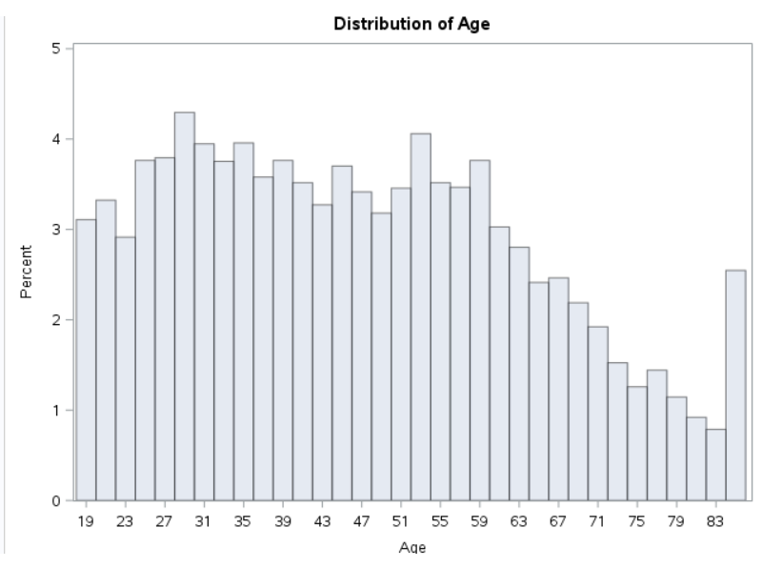
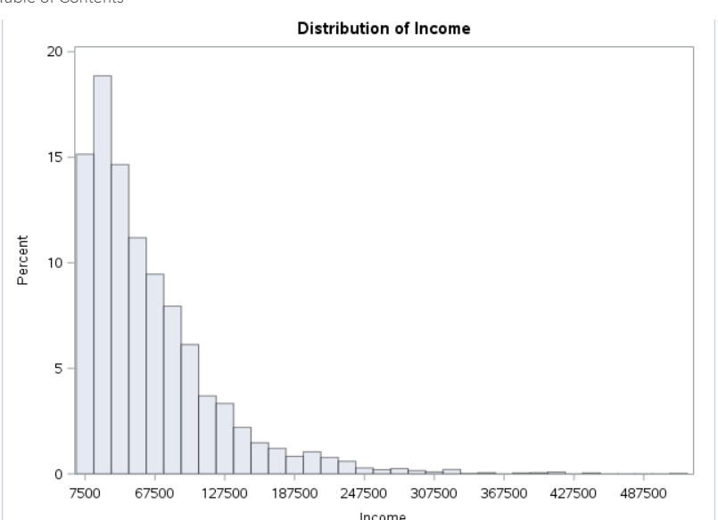
Age and Income Sample Demographics

Slide 13
Descriptive Statistics --
Of those who saw a dentist, the mean number of visits was 2
38.2 % of people in the sample had dental insurance in 2015.
54% of those with insurance saw a dentist at least 1 time in 2015.
46% of those with no insurance saw a dentist at least 1 time in 2015.
Insured people had a mean personal income of $47406, and family income of $88,554.
Uninsured people had a mean personal income of $23450, and family income of $43,714.
.

Slide 14
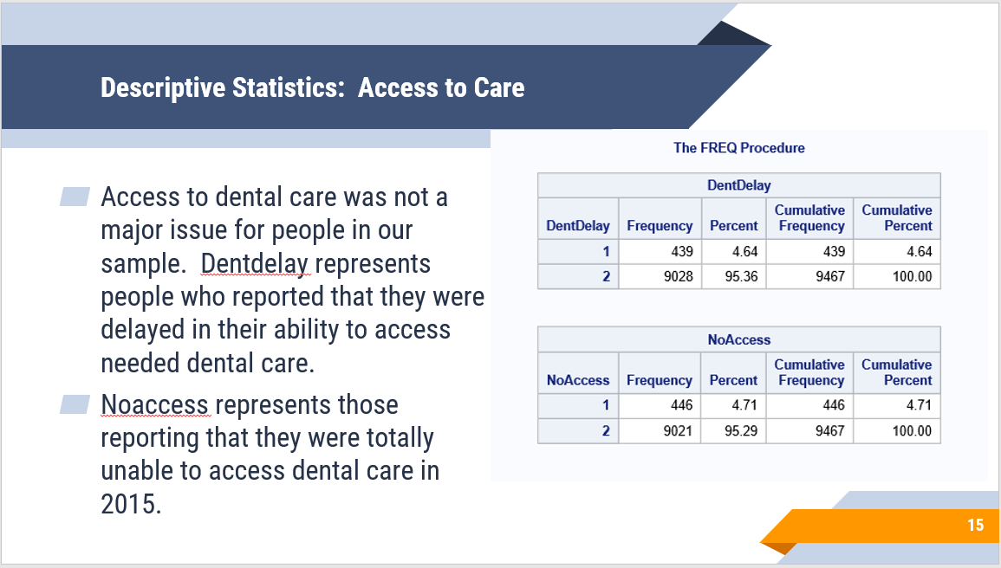
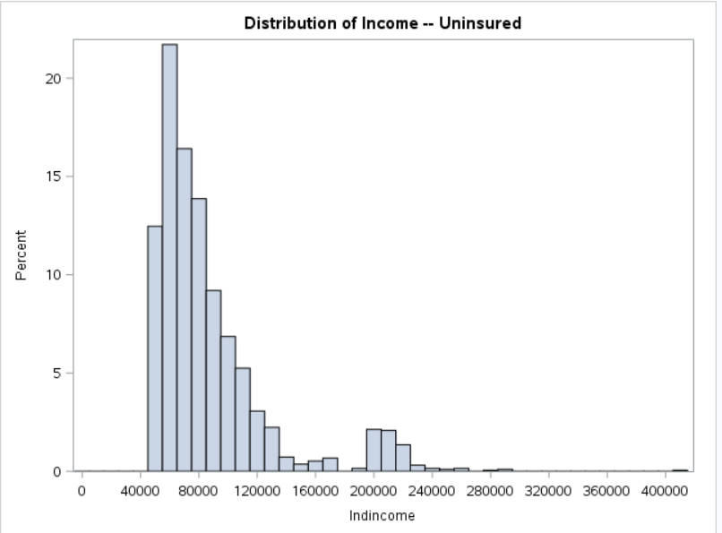
Notes:
It is interesting that access to care isn’t more of an issue considering that the mean income of people without insurance in our sample was 23k. So, there doesn’t appear to be a large cohort of people in this (national) sample who are encounter issues accessing care.

Slide 15
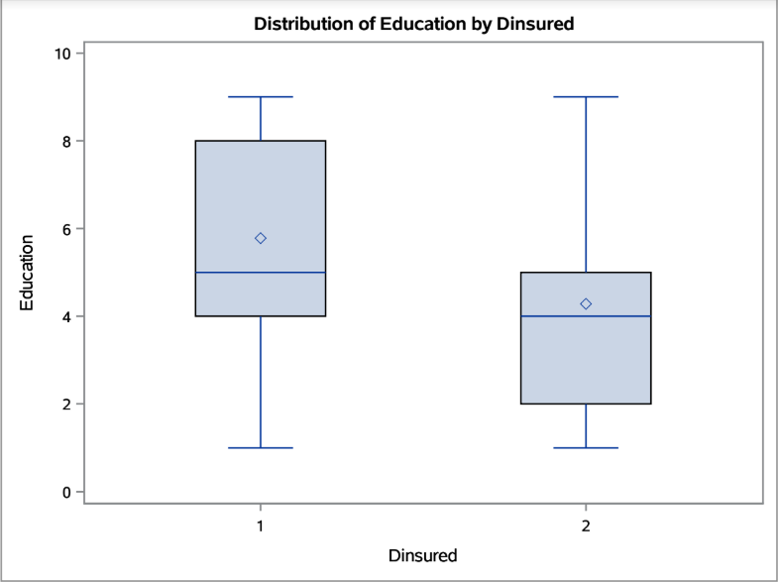
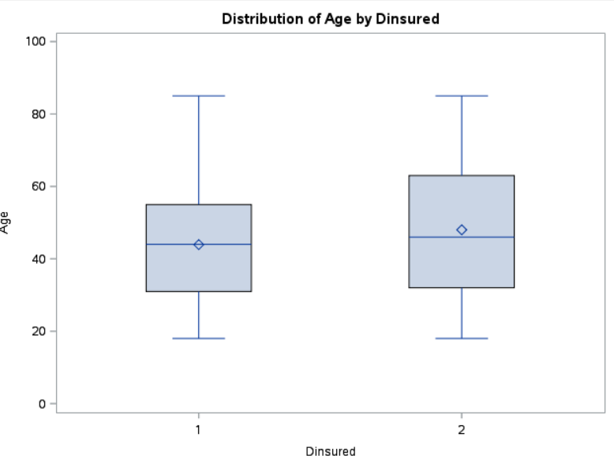
Demographics by Insurance status

Slide 16
Factor Analysis
Factor Analysis (on people with or without dental insurance) → Of predicted candidates to purchase insurance, what are the variables that help us understand what variables are the most statistically significant?
Tried several different models. Best one utilized Varimax
We found 6 factors explaining 73.96% of variation the data.
Factor 1: Financials/Income and Frequency of visits (all cause)
Factor 2: Barriers to access
Factor 3: Regular check-ups
Factor 4: Marital Status and Aging
Factor 5: Gender and Regular Medical Checkups
Factor 6: Family Structure

Slide 17
Logistic Regression
Y is whether or not patient has dental insurance
Model1: Uses Factors, Varimax
Model2: Uses stepwise regression of variables directly
Comparable Results for Model 1 and Model2
Both models significant at .05
All factors are significant in Model1
Significant variables in Model2: Marital Status, Age, Income, Gender, Dental Expenses Annually, College Education, Family Size, Partakes of Dental Checkups

Slide 18
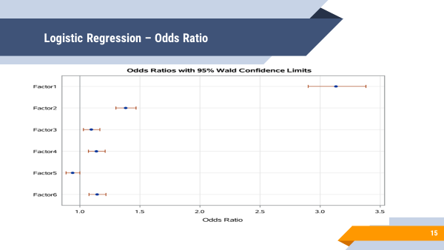
Confusion Matrix

Slide 19
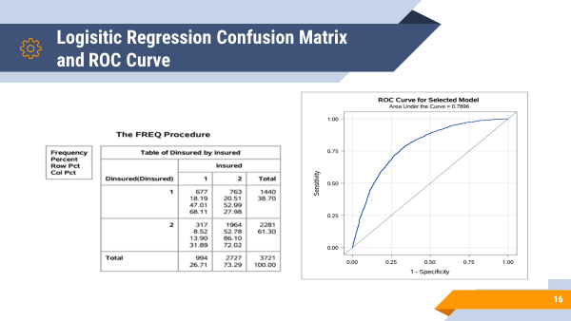

Slide 20
Multiple Regression
Y:Number of Visits Per Year
X: Delays accessing care, Family Size, Family Income and Expenditure on Dentistry
Model and all x variables are significant at .0001
R2 = 42.78%
Note: Model based on factors only explained ~2% so we dropped that model
-----------------------------------------------------------------------------------

Slide 21
Multiple Regression
Y: Total spending on dentistry
X: Out of pocket Number of Visits
Model and all x variables are significant at .0001
R2 = 41.52% when model is run for those who don’t have insurance
R2 = 38.89% when model is run for those who have insurance
Note: Model based on factors only explained 20% so we dropped that model
-----------------------------------------------------------------------------------

Slide 22
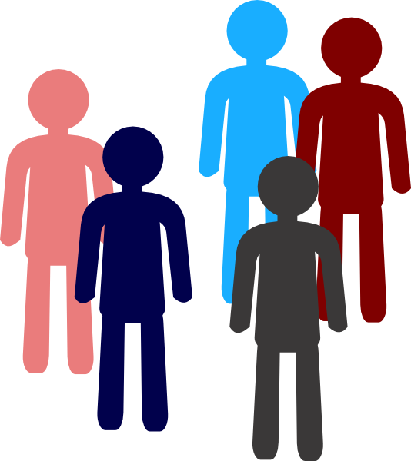
Measuring Marketing Efficacy: A/B Testing
Deploy a campaign to two different uninsured clusters.
Of those who successfully purchased insurance; compare.
Different Results→“Why?”
Similar Results→ Conversion “successful?”
Cluster A
Cluster B

Slide 23
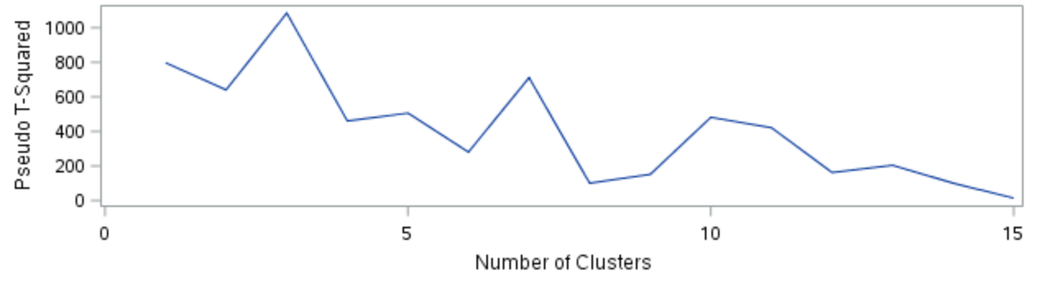
Finding K
Notes:
Supervised learning models Factor Analysis and Ward Clustering was only used to determine how many clusters would work best. Peaks at 3, 5, 7, and 10 although 3, 7 and 10 had 1 or more cluster frequencies less than 10.
Unsupervised clustering method of K-Means was used to eliminate assumptions regarding demographic variables that could be made within supervised models.

Slide 24
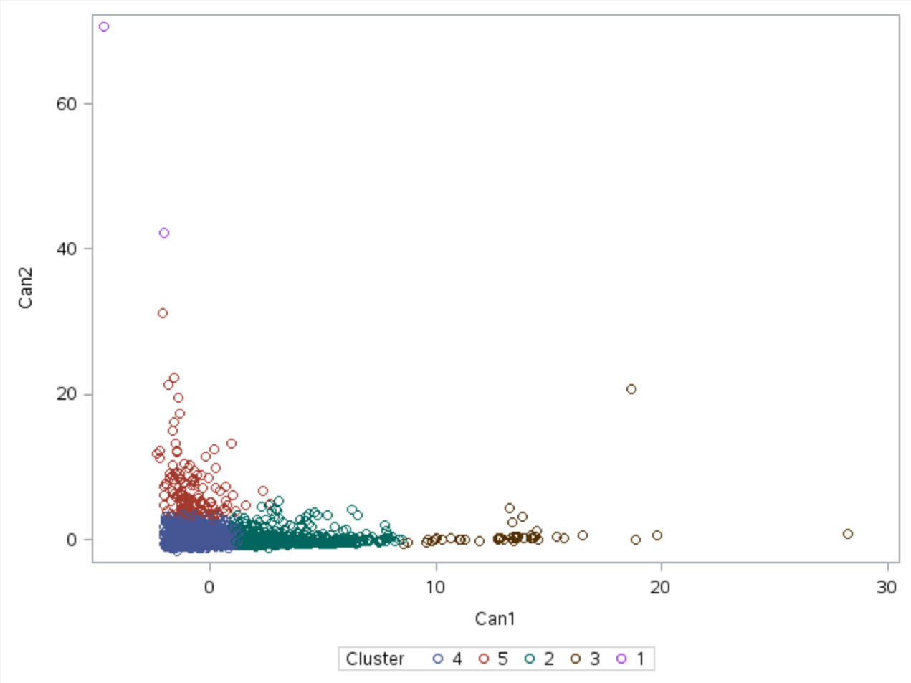
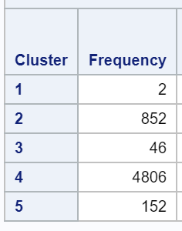
K-Means Clustering
A/B Marketing Test
on
Cluster 3 & Cluster 5
because they represent the two uninsured clustered populations that are least like one another.
Alternatively, Cluster 2 & 4
Notes:
About 3k people without dental insurance were clustered. Dropped duplicative fields Marry53 & tothccharge. Also took out income since it was such a strong predictor. Marketing budgets that are more conservative should use 4&5; more robust campaigns can test on cluster 2 and 4. Algorithm clusters assume inherent differences.

Slide 25
Conclusion
As a Marketer…
A lot was learned about how a marketing department can utilize demographic information for various aspects of a robust marketing campaign including:
Who: Predicted uninsured population
What: Identified factors that constitute uninsured people
Why: Predicted spend helps determine budgets
How: A/B Testing on clusters determines campaign efficacy

Slide 26
References
Glied, Sherry; Neidell, Matthew. (2008). The economic value of teeth. The National Bureau of Economic Research. Retrieved from: http://www.nber.org/papers/w13879
Hembree, Diana. (March 28, 2017). Why millenials aren’t smiling: bad teeth hinder 28% in job search. Forbes. Retrieved from: (March 28, 2017).
https://www.forbes.com/sites/dianahembree/2017/03/28/why-some-millennials-arent-smiling-bad-teeth-hinder-28-in-job-search/#6940d4a559c6
National Association of Dental Plans (2018). Who has dental plans today? Retrieved from: http://www.nadp.org/Dental_Benefits_Basics/Dental_BB_1.aspx
Trohel, Gilda; Bertraud-Gounot, Valerie; Soler, Marion; Chauvin, Pierre; Grimaud, Oliver. (July 16, 2016). Socio-Economic Determinants of the Need for Dental Care in Adults
Plos One. Retrieved from: https://www.ncbi.nlm.nih.gov/pmc/articles/PMC4956297/

Slide 27
References
US Department of Health and Human Services. (2014). Healthy People 2020: Oral health. Retrieved from: https://www.healthypeople.gov/2020/leading-health-indicators/2020-lhi-topics/Oral-Health/determinants
World Dental Federation. (2018). Oral health and the social determinants of health. Retrieved from: https://www.fdiworlddental.org/resources/policy-statements-and-resolutions/oral-health-and-the-social-determinants-of-health

Slide 28
THANKS!
Any questions?

